Slide 1
Traffic Accident Analysis
MIS 620 Fall 2017 – Group Project
Deepika Siriah
Lee Parker
Rashmi Sawant
Shraddha Masuti

Slide 2
Project Overview
Discovery
Model Planning
Model Building
Communicate Results
Operationalize
Data Preparation
Subject: Traffic accidents and severity (Data source: Road Accidents Data - kaggle.com)
Purpose : Analyze the data and attempt to determine predictors for severity

Slide 3
Agenda
Discovery
Model Planning
Model Building
Communicate Results
Operationalize
Data Preparation
Approach
Models
Main Findings
Recommendation

Slide 4
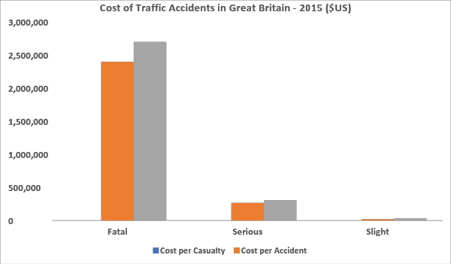
Cost of Accidents
Discovery
Model Planning
Model Building
Communicate Results
Operationalize
Data Preparation
Souce: Statistica.com

Slide 5
Project Goals
Discovery
Model Planning
Model Building
Communicate Results
Operationalize
Data Preparation
Identify possible predictors of road accidents
Predict accident severity
Identify the best predictive model for determining severity when an accident occurs

Slide 6
Value of the Analysis
Discovery
Model Planning
Model Building
Communicate Results
Operationalize
Data Preparation
If key predictors can be identified:
The information can aid government civil engineers, road and city planners, etc in design and implementation of safer roads
Ex. Signalized intersections vs Roundabouts
Design factors that optimize traffic flow balanced against pedestrian safety, bicycle safety, etc
The information can be used for risk measurement for insurance and determination of liability
Identify other information that needs to be collected to improve the analysis

Slide 7
First Look at the Data
Discovery
Model Planning
Model Building
Communicate Results
Operationalize
Data Preparation
Raw Data:
285K rows (accident reports)
70 columns (potential predictors)
Many columns had a preponderance of missing values
Several columns which had no predictive value
Ex. Number of casualties, police officer attended the site etc.

Slide 8
Grooming the Data
Discovery
Model Planning
Model Building
Communicate Results
Operationalize
Data Preparation
Categorical data was in numeric form
Removed predictors:
Irrelevant/ Missing Data
Duplicates
Correlated
Narrowed to 22 predictors
Removed rows with missing data or NA – ended with ~145K rows
Dependent variable = Accident Severity
Serious
Slight

Slide 9
Modeling
Discovery
Operationalize
Data Preparation
Communicate Results
Model Planning
Model Building
70/30 split between training data and test data
Balancing the data
SMOTE – poor performance
Used ROSE for this project
10-fold Cross Validation

Slide 10
Modeling
Discovery
Model Planning
Model Building
Communicate Results
Operationalize
Data Preparation
Decision Tree
Naïve Bayes
Random forest
Boosting
Bagging
Neural Network

Slide 11
Predictors
Discovery
Operationalize
Data Preparation
Communicate Results
Model Planning
Model Building
Radom Forest
# Vehicles
Speed Limit
Driver Age
Location
Veh. Manvr
Bagging
# Vehicles
Speed Limit
Driver Age
Location
Veh. Manvr
Naive Bayes
Veh. Type
Veh. Manvr
Speed Limit
Urban/Rural
Driver Gender
Boosting
Veh. Type
Veh. Manvr
Speed Limit
Urban/Rural
Driver Gender
Decision Tree
# Vehicles
Veh. Type
Veh. Manvr
Speed Limit
Location
Neural Network
Location
# Vehicles
Driver Gender
Urban/Rural
Veh. Manvr

Slide 12
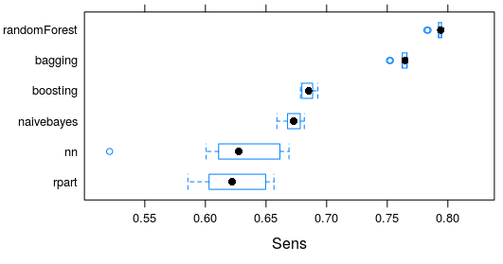
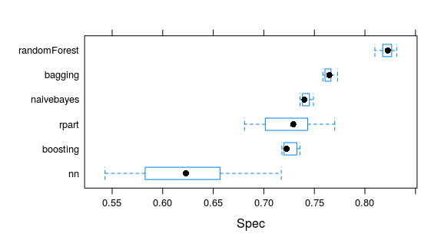
Main Findings
Discovery
Operationalize
Data Preparation
Communicate Results
Model Planning
Model Building

Slide 13
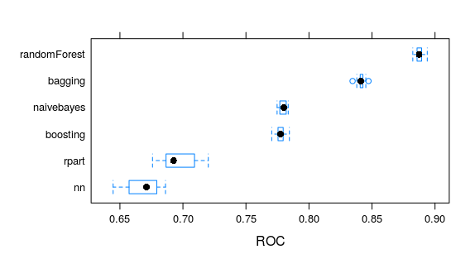
Main Findings
Discovery
Operationalize
Data Preparation
Communicate Results
Model Planning
Model Building

Slide 14
Main Findings
Discovery
Operationalize
Data Preparation
Communicate Results
Model Planning
Model Building

Slide 15
Recommendations
Discovery
Model Planning
Model Building
Communicate Results
Operationalize
Data Preparation
Improve the models
Different predictor combinations
Add layers in NN
Work on outliers
Additional data that may be useful
Ex. Reported vehicle speed at time of crash

